Slide 1
Building Block of PHP
03

Slide 2

Setting Up Development Environment
Download and Install XAMPP
X - CROSS PLATFORM
A - APACHE
M - MARIADB
P - PHP
P - PERL
https://www.apachefriends.org

Slide 3
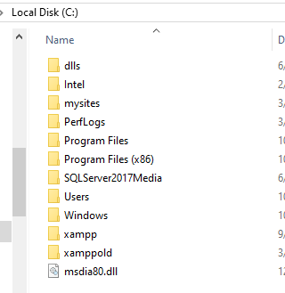
The location of the xampp folder installation is usually in C:

Slide 4
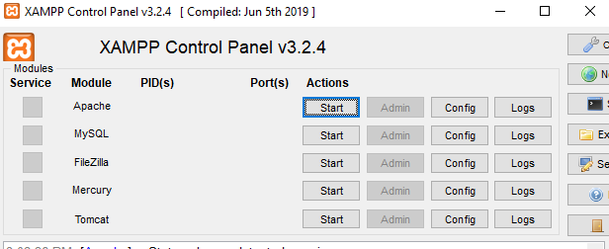
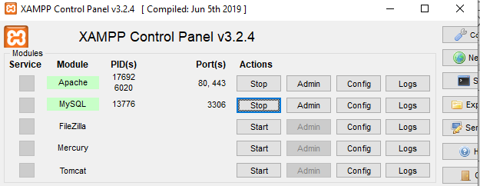

Slide 5
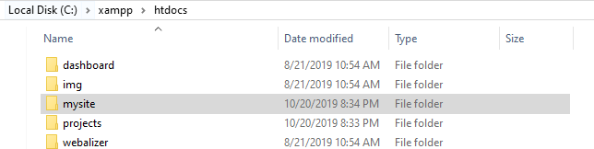
Add ‘mysite’ folder

Slide 6
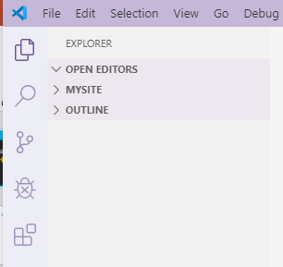
Working with VS Code
Open VS Code
Go to File > Open Folder
Select the ‘mysite’ located at
C:/xampp/htdocs/mysite

